Slide 1

Smart Screen Saver
Team
  Abdelrady Elagamy Abdelrady
  Ali Hussien Ahmed
    IT Department
    Under Supervision of
    Dr. Khaled F.Hussien

Slide 2
بِسْمِ اللهِ الرَّحْمنِ الرَّحِيمِ
قَالُواْ سُبْحَانَكَ لاَ عِلْمَ لَنَا إِلاَّ مَا عَلَّمْتَنَا إِنَّكَ أَنتَ الْعَلِيمُ الْحَكِيمُ
سورة ال عمران(الايه ٣٢)

Slide 3
Implementation Details
Language: C#.net,C++.net.
Tool: MS .Net 2005 IDE , OpenCV.
Application type: Windows application.
Prerequisites:
  MS .netFramework2.
  Webcam.
    Tested with Creative Webcam

Slide 4
Description
An application based on the detection of human face during the use of the personal computer , once user had leave the computer for while, the Smart Screen Saver activated ,if user arrived the Smart Screen Saver detects him and deactivates the computer Screen saver.

Slide 5
Details
Application can be divided into four steps
Capturing Data.
Human face detection.
Human face recognition.
Decision.

Slide 6
Capturing Data.
This is the easiest step in our project That concerns with Connecting to Camera and Fetch Frames to be processed.
So this step will not discussed here.

Slide 7
Human face detection…

Slide 8
The determination whether there are Human faces in camera frames or not.
It the core step in the project.
We have used the OpenCV open source code and reformulate, manifest and collect functions that we need in separate Wrapper DLL.
Called FaceDetection.dll.
This dll written in C++.Net

Slide 9
Steps Followed
Object Initialization
  Include loading cascades files
Create Memory Storage that contain Images
Start Capturing From Camera
  Or you can capture from AVI File
Convert Image To RGB Scale

Slide 10
Steps Followed
Resize Image
Perform Histogram Equalization On Image
Set Images region of interest (ROI)
Detect Faces From Equalized Images With cascades Files
Show Camera Frames With Faces Detected Within rectangles

Slide 11
What is Beneath FaceDetection.dll?
clsFaceDetectionWrapper.h
FaceLocator.h
ObjectLocator.h
Implemented in
clsFaceDetectionWrapper.cpp
FaceLocator.cpp
ObjectLocator.cpp

Slide 12
Objects Initialization
FaceLocator::FaceLocator(void)
{
FaceDetector = new ObjectLocator();
LeftEyeDetector = new ObjectLocator();
RightEyeDetector = new ObjectLocator();
}
ObjectLocator::ObjectLocator()
{
int i,j;
storage = NULL;
cascade = NULL;
NoOfObjects=0;
object_location = new int __gc[MAXOBJECTCOUNT,4];
//MAXOBJECTCOUNT=5
for (i=0;i<MAXOBJECTCOUNT;i++)
for (j=0;j<4;j++)
object_location[i,j] = 0;
}

Slide 13
Objects Initialization
//FaceLocator.h
static System::String * FaceCascade = "\\Cascades\\haarcascade_frontalface_alt.xml";
static System::String * RightEyeCascade = "\\Cascades\\ojoD.xml";
static System::String * LeftEyeCascade = "\\Cascades\\ojoI.xml";
void InitCascades();
//FaceLocator.cpp
void FaceLocator::InitCascades(void)
{
char* face = StringToCharPtr(str->Concat(str,FaceCascade));
FaceDetector->InitObjectDetect(face);
char* leye = StringToCharPtr(str->Concat(str,LeftEyeCascade));
LeftEyeDetector->InitObjectDetect(leye);
char* reye = StringToCharPtr(str->Concat(str,RightEyeCascade));
RightEyeDetector->InitObjectDetect(reye);
}

Slide 14
Class clsFaceDetection
Prepare the clsFaceDetectionWrapper object that all operations will be on the passed frame as pointer to Bitmap object
The passed frame will be
    Scale image by factor of 1.3
    Set color depth to be 8 bit grayscale
    With only one channel !
    Also convert from Managed Image to IplImage this is the object type that OpenCV Deals with
    Return the number of detected faces
int clsFaceDetectionWrapper::WrapDetectFaces(System::Drawing::Bitmap* Image)
{
IplImage* ImageData = cvCreateImage(cvSize(Image->Width,Image->Height),8,1);
int i=0;
for (int y=0;y<Image->Height;y++)
{
for (int x=0;x<Image->Width;x++)
{
ImageData->imageData[i++] =(char)Image->GetPixel(x,y).ToArgb(); }
}
return faceLocator->DetectFaces(ImageData);
}
Number of channels per element(pixel). Can be 1, 2, 3 or 4. A,R,G, And B

Slide 15
Class clsFaceDetection cont
→Inside faceLocator.cpp
int FaceLocator::DetectFaces(IplImage* inputImage)
{
if(InitFlag==0)
{
InitFlag++;
CurrentFaceDetector->InitImageStorage(inputImage->width,inputImage->height, scale);
InitCascades(); //load cascades from The XML File
lastHeight = inputImage->height;
lastWidth = inputImage->width;
}
else if((lastHeight!=inputImage->height) || (lastWidth!=inputImage->width))
{
CurrentFaceDetector->InitImageStorage(inputImage->width,inputImage->height, scale);
InitCascades();
lastHeight = inputImage->height;
lastWidth = inputImage->width;
}
CurrentFaceDetector->ManagedImagetoUnManagedImage((inputImage));
CurrentFaceDetector->ImagePreProcessForFaceDetection(); //resize scale,.. image
CurrentFaceDetector->UnSetFaceROI();
int FNum = CurrentFaceDetector->DetectObjects();
return FNum;
}
Here the conversation from the mange to unmanaged image
By taking a copy from image data ,operations will not applied in
the captured frame directly

Slide 16
Class clsFaceDetection cont
→Inside objectLocator.cpp
int ObjectLocator::DetectObjects()
{
int i;
cvClearMemStorage( storage );
NoOfObjects = 0;
if( cascade )
{
//returns the detected objects
CvSeq* objects = cvHaarDetectObjects( small_image, cascade, storage, 1.1, 2, 0, cvSize(30, 30) );
NoOfObjects = objects->total;
CvRect r;
for( i = 0; i < (objects ? objects->total : 0); i++ )
{
if (i<MAXOBJECTCOUNT)
{
r = *(CvRect*)cvGetSeqElem( objects, i );
object_location[i,0] = (int)(r.x*scale);
object_location[i,1] = (int)(r.y*scale);
object_location[i,2] = (int)(r.width*scale);
object_location[i,3] = (int)(r.height*scale);
}
}
cvFree(&r); //clean memory
cvFree(&objects);
}
return (NoOfObjects>MAXOBJECTCOUNT)?MAXOBJECTCOUNT:NoOfObjects;
}
The native cv function that detect objects

Slide 17
→Inside CV.h
cvHaarDetectObjects() Declaration
CvSeq* cvHaarDetectObjects( const CvArr* image, CvHaarClassifierCascade* cascade, CvMemStorage* storage, double scale_factor=1.1, int min_neighbors=3, int flags=0, CvSize min_size=cvSize(0,0) );
Image: Image to detect objects in.
Cascade: Haar classifier cascade in internal representation.
Storage: Memory storage to store the resultant sequence of the object candidate rectangles.
scale_factor: The factor by which the search window is scaled between the subsequent scans, for example, 1.1 means increasing window by 10%.
min_neighbors: Minimum number (minus 1) of neighbor rectangles that makes up an object. All the groups of a smaller number of rectangles than min_neighbors-1 are rejected. If min_neighbors is 0, the function does not any grouping at all and returns all the detected candidate rectangles, which may be useful if the user wants to apply a customized grouping procedure.
Flags: Mode of operation. Currently the only flag that may be specified is CV_HAAR_DO_CANNY_PRUNING. If it is set, the function uses Canny edge detector to reject some image regions that contain too few or too much edges and thus can not contain the searched object. The particular threshold values are tuned for face detection and in this case the pruning speeds up the processing.
min_size: Minimum window size. By default, it is set to the size of samples the classifier has been trained on (~20×20 for face detection).

Slide 18
Briefly
OpenCV does not concern with faces only, but also it can detect any object that is characterized by cascade file written in XML.
Cascade file contains objects features, thresholds and limits that is used by openCV to Detect Object.

Slide 19
Cascade Example
<!-- tree 7 -->
<_>
<!-- root node -->
<feature>
<rects>
<_>0 7 20 6 -1.</_>
<_>0 9 20 2 3.</_>
</rects>
<tilted>0</tilted>
</feature>
<threshold>2.6365420781075954e-003</threshold>
<left_val>0.2309329062700272</left_val>
<right_val>0.5695425868034363</right_val>
</_>

Slide 20
Give me coordinates ..!!!!
OK there are a face what’s next?

Slide 21
Class clsFaceDetectionWrapper cont
Face coordinates are retrieved and a rectangle is drawn around face
int clsFaceDetectionWrapper::WrapGetFaceCordinates(int index, int &lx, int &ly, int &rx, int &ry)
{
return faceLocator->GetFaceCordinates(index, lx, ly, rx, ry);
}
//which fills the coordinates with the face location else zeros will returned

Slide 22
Class clsFaceDetectionWrapper cont
→Inside faceLocator.cpp
int FaceLocator::GetFaceCordinates(int index, int &lx, int &ly, int &rx, int &ry)
{
int lx1, ly1, rx1, ry1;
CurrentFaceDetector->GetObjectCoordinates(index, lx1, ly1, rx1, ry1);
lx = lx1;
ly = ly1;
rx = rx1;
ry = ry1;
return 0;
}
void ObjectLocator::GetObjectCoordinates(int oNum, int &tx, int &ty, int &bx, int &by)
{
if(oNum<NoOfObjects)
{
tx = object_location[oNum,0];
ty = object_location[oNum,1];
bx = object_location[oNum,2];
by = object_location[oNum,3];
}
else
{
tx=ty=bx=by=0;
}
}
stores the locations of detected objects

Slide 23
Using The Wrapper Dll In C# Application
Our Signature
The Main Application

Slide 24
private clsFaceDetectionWrapper objFaceDetector;
//Our main Object that interfaces OPENCV
int faces = objFaceDetector.WrapDetectFaces(lastPic);
//Get the coordinates from the Captured Frame
objFaceDetector.WrapGetFaceCordinates(f, &lx, &ly, &rx, &ry);
//Get Face Coordinates
picGraphics.DrawRectangle(myPen,
lx * ((float)picDetectFaces.Width / lastPic.Width),
ly * ((float)picDetectFaces.Height / lastPic.Height),
rx * ((float)picDetectFaces.Width / lastPic.Width),
ry * ((float)picDetectFaces.Height / lastPic.Height));
//Now Draw The Rectangle

Slide 25
res = bjFaceDetector.WrapGetEyeCordinates
(f, &lx, &ly, &rx, &ry);
//Get The Eye Coordinates to Form “the weak” Distinguishing feature
//Calculate the value of the feature
int f1 = Math.Abs(fy - ly);
int f2 = Math.Abs(fy - ry);
fm = (double)(f1 + f2) / 2;
fm /= height;
fm *= 1000;

Slide 26
Detect face once every fixed predetermined frames as applying algorithm in all frames results a very slow program .
but they are Chosen so that there is no radical changes within them.
The detected faces in the key frames are used to draw rectangle to the near frames.

Slide 27
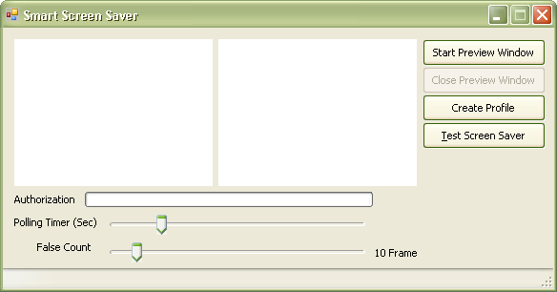
Application-Idle

Slide 28
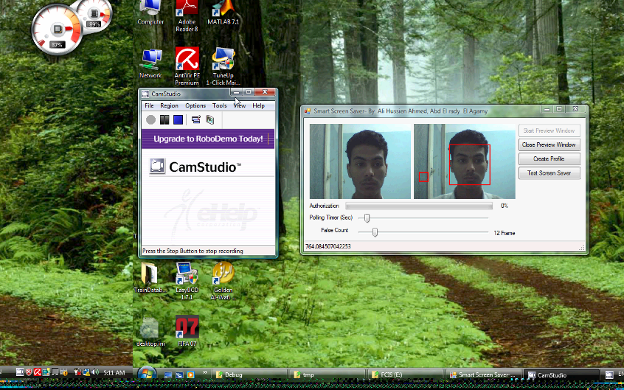
Application-Testing

Slide 29
Start Application

Slide 30
References
Face and Eyes Detection Using OpenCV
  http://www.codeproject.com/KB/library/eyes.aspx
Intel® Open Source Computer Vision Library (Samples)
  FaceDetect.c
  http://www.sourceforge.net/projects/opencvlibrary/

Slide 31
Thanks

